Slide 1
SQL Final Project
Group 1

Slide 2
Question
Is there any correlation between number of wins and team salary? Use data from 2000 and later to answer this question. As you do this analysis, keep in mind that salaries across the whole league tend to increase together, so you may want to look on a year-by-year basis.

Slide 3
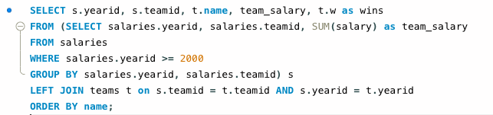
SQL Code

Slide 4
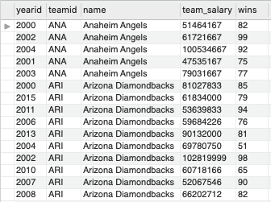
SQL Results - ordered by team name

Slide 5
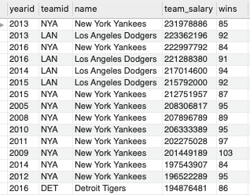
SQL Results - ordered by team salary (descending)

Slide 6
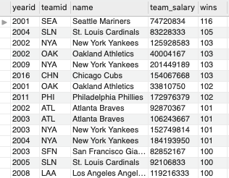
SQL Results - ordered by wins (descending)

Slide 7
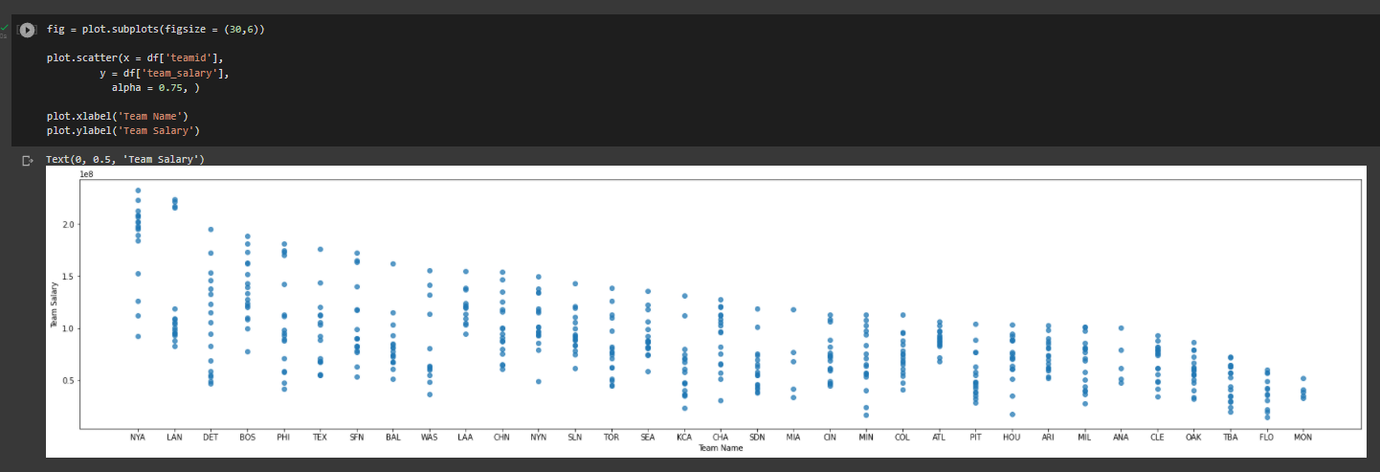
Selected Visualizations

Slide 8
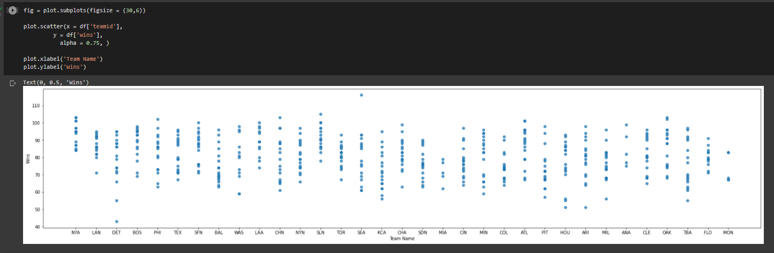
Selected Visualizations

Slide 9
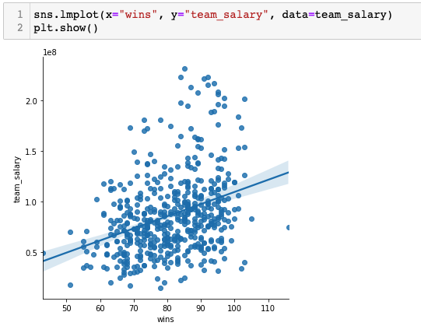
Python Visualization

Slide 10
Conclusion
No significant correlation between number of team wins and salary
Team salary based on other factors… may be location, attendance, population density, etc.
New York Yankees in 2013 and the Los Angeles Dodgers in 2013 were the top highest salaried teams
Seattle Mariners in 2001 and the St. Louis Cardinals in 2004 had the most wins

